Slide 1

Personal Goal Setting and Motivation

Slide 2
A New World
The University is a new world that strikes every fresh student with the discovery of freedom, lofty ideas and great expectations.
The University will help you to journey from “the you of now” to the “you to be” – through goal setting and pursuit of those goals.
Your goals ought to identify with the classical vision of University, which is:
S – Seeking the truth
T - Transmitting the truth
U – Universal outlook
F - Freedom
H – Harmony with others
S – Service to humanity

Slide 3

What is a goal?
What is a goal?
Write down an answer.

Slide 4
What is a goal?
Definition - A goal is an end toward which you direct specific effort; something you are working toward achieving.
Synonyms – Target, Purpose, Intention, Objective

Slide 5
What is Goal Setting?
Goal setting is the process of establishing an outcome (a goal) to serve as the aim of your actions.
Setting goals drive people through their present selves to future selves.
Source: http://vpal.harvard.edu/publications/setting-goals-who-why-how

Slide 6
Goal Setting: Who, Why, How?
Goal setting can be:
1. Personal
2. Collaborative
3. By third party (parent, teacher, mentor, e.t.c.)

Slide 7
Contd
Personal Goal Setting…
Working out your personal life in readiness for your professional life.
Set Personal Goals,
Education Goals,
Career Goals,
Life Goals,
Ultimate Goal(s).

Slide 8

Why Set Goals
Goals propel you forward.
Goals remind us what’s important to us.
Accomplishing goals builds self-confidence.
Goals hold us accountable for failure.
Goals help us live life to the fullest.

Slide 9

Don’t have a Goal?
What happens when you don’t have a goal for something important?
No goal for your day?
No goal for your week?
How do you end up spending your time?

Slide 10
Committing to Your Goals
Goals work better when they are:
Your goals - meaningful to you, focused on the things that are important to you, you are committed to them
Positive goals - “I want to make the UN’s scholarship List” vs “I want to avoid getting put on academic probation”
Notes:
It’s hard to keep the motivation and the drive to accomplish someone else’s goals. Your parents may want you to be a lawyer, but at some point you may realize that you have no interest in the law, no apparent ability to do the work to become a lawyer – it’s going to be really hard to stay in school, take all the classes you need to take, graduate, pass the LSAT, then go all the way though Law School, just because your parents wanted you to be a lawyer.
Working toward positive goals feels like we are accomplishing something. Something positive. Something good. Something to be proud of.

Slide 11
What are your goals?
Possible answers
Go to class on time
Study more
Keep up with studies
Put God first
Start going to class more and getting my friends to as well
Work harder
Take a leadership role
Graduate from PAU
Take initiative and don’t be a follower
Make better grades
Get a better job after graduation from PAU
Stay true to my beliefs
Raise my CGPA
Meet new people

Slide 12



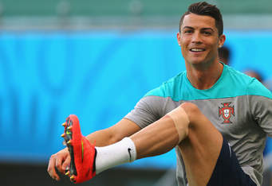


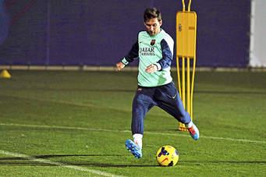
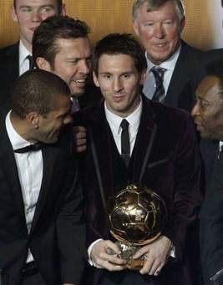



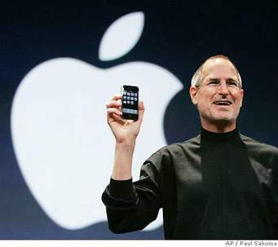
If your goals are really important to you, you will invest more time in them.

Slide 13


How?
S - Specific
M – Measurable
A – Achievable, Ambitious, Adjustable
R – Relevant
T - Timely

Slide 14

Specific
KEEP IT VERY SPECIFIC AND WELL SPELT OUT
Collins says, I will learn how to play any musical instrument in PAU (not specific)
Henri says, I will learn how to play the piano before 24th of December 2021. (specific and timely as well)
Chidi says, I want to earn at least a 3.00 CGPA at the end of this session
Dami says, I will study 10 hours a week for my Accounting class this semester

Slide 15
Measurable
Measurable
Is your goal quantitative? Is there a way to see if you’re accomplishing it?
Use of Library – I will submit ALL of my assignments to the Faculty at least 48 hours before they are due.
World civilization – I will complete ALL assigned reading for the week prior to the start of the class.
Logic – I will complete 85% of all the practice problems before the next class.

Slide 16
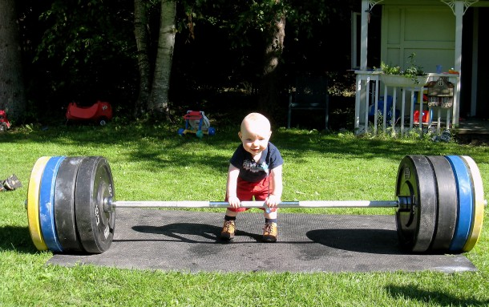


Achievable
Our goals need to be achievable. Otherwise, we are setting ourselves up for constant disappointment when we don’t achieve them.

Slide 17
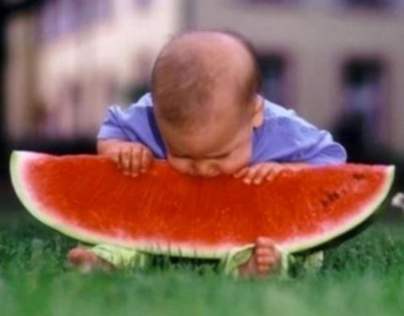
Ambitious
Our goals should be achievable, but they also need to be ambitious
Goals need to be a challenge. Then we work, and work, and work, and we achieve it. It’s a great feeling.

Slide 18
Adjustable
It’s important to review and assess your goals. If you’re not getting the grades you want you may have to rewrite goals to get the outcome you’re looking for.
Use of Library – I will submit ALL of my assignments to the Faculty at least 48hrs/24 hours before they are due.
World civilization – I will complete ALL assigned reading for the week prior to the start of the class/by Sunday evening.
Logic – I will complete 85% /70% of all the practice problems before the next class

Slide 19
Relevant
Your goals should help you make progress toward achieving the things that are important to you.
We don’t need to set goals for things that aren’t important, so first we need to know, what is important to me?
Think about your values, what do you want to accomplish tomorrow? This semester? In your life?

Slide 20
Timely
This is the other half of measurable. When do you plan to accomplish things.
Use of Library – I will submit all of my assignments to the Faculty at least 24 hours before they are due.
World civilization – I will complete all assigned reading for the week by Sunday evening.
Logic – I will complete 70% of all the practice problems before the next class
Without the ending, it becomes easier to procrastinate
KEEP YOUR GOALS TIMED

Slide 21

Put your SMART goals to work every day.
Be purposeful.
1. Pick the goals that are MOST important this semester.
2. Use your planner to assign time to those goals, and limit time on other things.
Notes:
Your call to action from our discussion tonight: PICK among your goals. What is MOST important to you this semester? Prioritize. Then write smart goals. Use your planner and assign time daily/weekly to your goals and LIMIT time on activities that not as important.

